Slide 1
GENERATIVE AI, DIGITAL DISPUTES & THE LAW
WHERE ARE WE?
LUKE MOULTON, WRIGHT HASSALL

Slide 2
WHAT DO WE MEAN BY AI?
"Artificial intelligence is that activity devoted to making machines intelligent, and intelligence is that quality that enables an entity to function appropriately and with foresight in its environment." (Prof Nils J Nilsson, The Quest for Artificial Intelligence: A History of Ideas and Achievements (Cambridge University Press, 2010).
Examples of Generative AI models:
ChatGPT;
Dall-E; &
Stability Diffusion.
AI/Generative AI Use cases:
Chat bots (customer service/technical support);
Content generation;
Trend analysis of consumer demand in retail;
“Personalisation” (adverts and suggestions); &
Recruitment (preparing CVs / sifting through CVs)

Slide 3
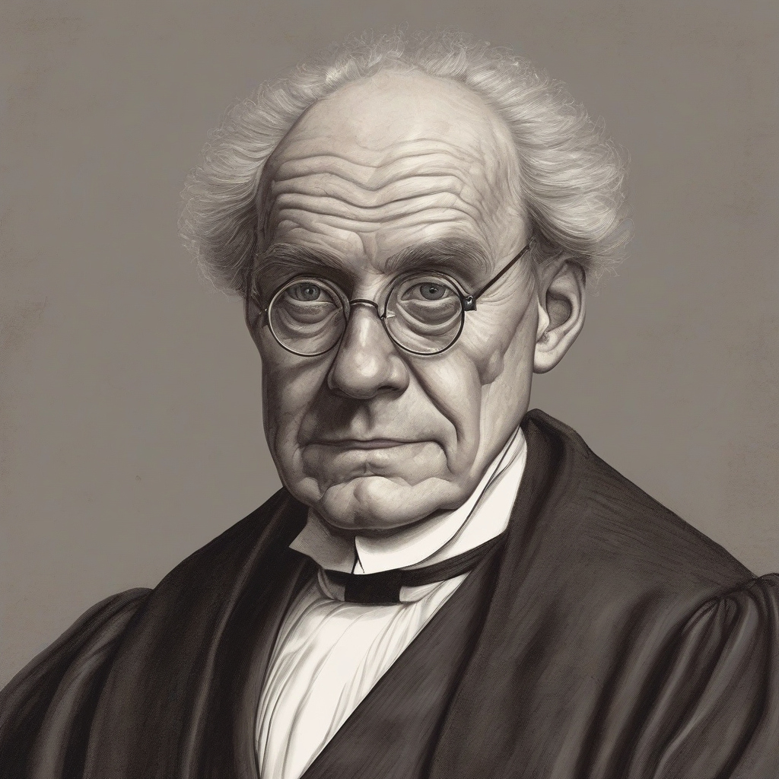

Slide 4
KEY IPRS AND WHAT THEY PROTECT
Copyright
Patents
Confidential Information
Trade marks /
Passing off
Designs
Artistic works (photographs / paintings), literary works (books / articles) drawings,
software code
Inventive technology (how it works)
Trade secrets &
knowhow
Branding,
Names &
Logos
Product designs
(how it looks)

Slide 5
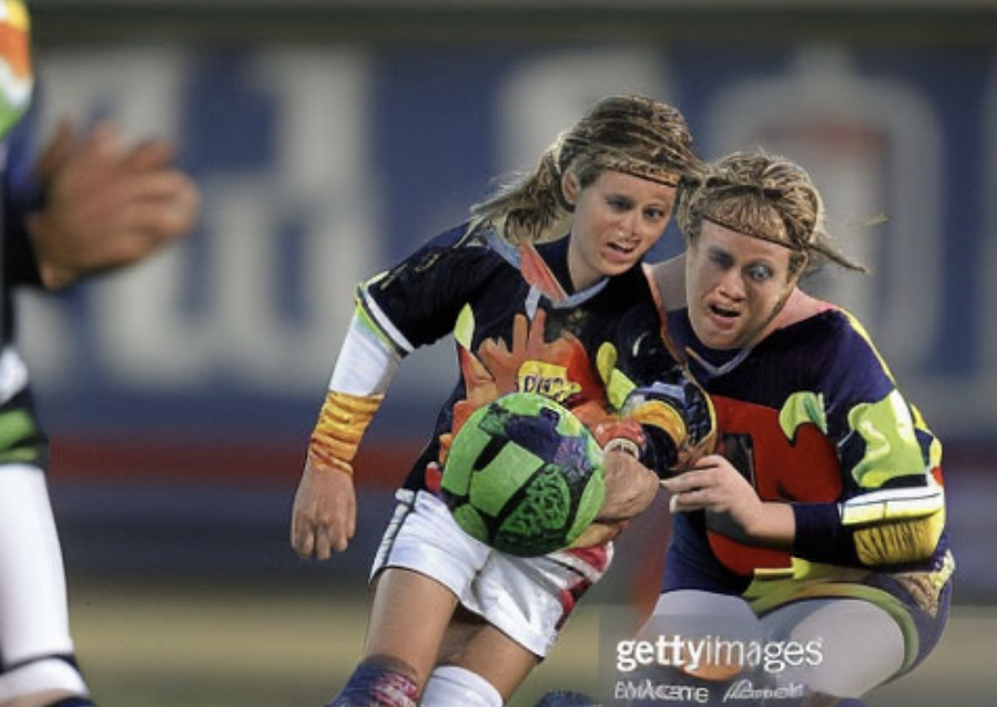
LEGAL ISSUES
Can AI own IP?
Thaler v Comptroller-General of Patents Designs and Trade Marks [2023] UKSC 49
Who owns IP in the content created using Generative AI?
Do Generative AI Models infringe IPRs?
Getty Images (US), Inc. & Ors v Stability AI Ltd (IL-2023-000007)
Could users of AI Models infringe IPRs?
Data protection compliance.

Slide 6
IMPACT ON BUSINESS
Use cases:
Customer Support Automation: AI-driven chatbots and virtual assistants provide 24/7 customer service, reducing wait times and operational costs;
Personalized Marketing: Generative AI creates tailored content and recommendations, improving customer engagement and sales;
Automated Content Creation: AI generates articles, scripts, and videos, speeding up production and cutting costs in media and entertainment;
Predictive Analytics in Finance: AI analyzes data to forecast trends, optimize investments, and enhance fraud detection in financial services;
Legal Process Automation: AI drafts legal documents, reviews contracts, and predicts case outcomes, improving efficiency in legal services.

Slide 7
IMPACT ON BUSINESS
Actions to mitigate risks associated with generative AI:
Understand the key legal and compliance risks with use;
Audit current use and consider potential uses;
Implement policies governing the use of generative AI; and
Tread carefully.

Slide 8
ANY QUESTIONS?
Luke Moulton,
Partner
luke.moulton@wrighthassall.co.uk

