Slide 1
WELCOME TO ‘FALLOUT’
Wednesday 20th November 2024

Slide 2
WELCOME
Nathan Talbott, Wright Hassall

Slide 3
9AM – 9.30AM | COFFEE & REGISTRATION
9.30AM – 10AM | WELCOME & KEYNOTE ADDRESS | NATHAN TALBOTT, WRIGHT HASSALL & PJ KIRBY KC, GATEHOUSE CHAMBERS
10AM – 11AM | BREAKOUT SESSIONS: CONTRACTUAL DISUPTES CORPORATE DISPUTES | RHYS JARMAN & IAIN COLVILLE, WRIGHT HASSALL (LECTURE THEATRE) PARMINDER TAKHAR, WRIGHT HASSALL (THIS ROOM)
10.55AM – 11.05AM | COFFEE BREAK
11.05AM – 12PM | BREAKOUT SESSIONS: CONTRACTUAL DISUPTES AI | RHYS JARMAN & IAIN COLVILLE, WRIGHT HASSALL (LECTURE THEATRE) LUKE MOULTON, WRIGHT HASSALL (THIS ROOM)
12PM - 1PM | PANEL SESSION | LED BY NATHAN TALBOTT, WRIGHT HASSALL WITH DR INEZ BROWN, IOD & TESSA MCINNES, NATIONAL GRID & ANN CRITCHELL-WARD, WRIGHT HASSALL
1PM – 2PM | LUNCH

Slide 4
KEYNOTE ADDRESS
PJ Kirby KC, Gatehouse Chambers

Slide 5
BREAKOUT SESSIONS:
CONTRACTUAL DISUPTES
RHYS JARMAN & IAIN COLVILLE, WRIGHT HASSALL (LECTURE THEATRE)
CORPORATE & SHAREHOLDER DISPUTES
PARMINDER TAKHAR, WRIGHT HASSALL (THIS ROOM)

Slide 6
CONTRACTUAL DISUPTES
10AM - UPSTAIRS
Claire Nichol
Claire Johnson-Cole
David Hunt
Dawn Lodge
Hannah Wright
Julia Berridge
Michael Mitchell
Michael Moran
Michaela Meeraus
Naomi Wood
Neil Hopkins
Nick Wright
Phil Hodges
Sandi Haigh
CORPORATE DISPUTES
10AM - THIS ROOM
Alan Walker
Adrian Pym
Anil Sohal
Brian Lewis
Bridget Deith
Charlotte Lepora
Daniel Goodall
Geraldine Evans
Gugu Sibanda
Henry Pocock
James Jobling
Jim Goudie
John Rimmer
Jonathan Griffiths
Lily Samuels
Mark Lawal
Nicola Keable
Parveen Sidhu
Richard Moxon
Shree Dhar Bhatia
Steve Compton
Wenhao Lyu
CONTRACTUAL DISUPTES
11.05AM - UPSTAIRS
Adrian Pym
Alan Walker
Brian Lewis
Bridget Deith
Charlotte Lepora
Geraldine Evans
Gugu Sibanda
Henry Pocock
James Jobling
Jim Goudie
Jonathan Griffiths
Lily Samuels
Mark Lawal
Nicola Keable
Parveen Sidhu
Richard Moxon
AI
11.05AM - THIS ROOM
Alyssa Kharwa
Anil Sohal
Claire Nichol
Claire Johnson-Cole
Daniel Goodall
David Hunt
Dawn Lodge
Hannah Wright
John Rimmer
Julia Berridge
Michael Mitchell
Michael Moran
Michaela Meeraus
Naomi Wood
Neil Hopkins
Nick Wright
Phil Hodges
Sandi Haigh
Shree Dhar Bhatia
Wenhao Lyu

Slide 7
CORPORATE & SHAREHOLDER DISPUTES
WITH PARMINDER TAKHAR & NATHAN TALBOTT

Slide 8
COFFEE BREAK

Slide 9
BREAKOUT SESSIONS:
CONTRACTUAL DISUPTES
RHYS JARMAN & IAIN COLVILLE, WRIGHT HASSALL (LECTURE THEATRE)
GENERATIVE AI, DIGITAL DISPUTES & THE LAW
LUKE MOULTON, WRIGHT HASSALL (THIS ROOM)

Slide 10
GENERATIVE AI, DIGITAL DISPUTES & THE LAW
WHERE ARE WE?
LUKE MOULTON, WRIGHT HASSALL

Slide 11
PANEL SESSION
ETHICAL DILEMMAS:
FOR DIRECTORS & PROFESSIONALS
LED BY NATHAN TALBOTT, WRIGHT HASSALL WITH
DR INEZ BROWN, IOD & TESSA MCINNES, NATIONAL GRID
& ANN CRITCHELL-WARD, WRIGHT HASSALL

Slide 12
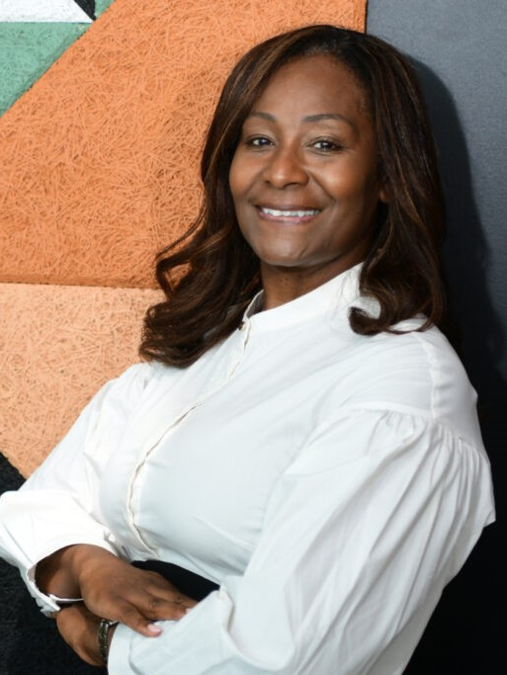
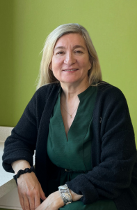
MEET THE PANEL
Dr Inez Brown
Regional Chair IoD Central, Institute of Directors
Tessa McInnes
Senior Lawyer, National Grid
Ann Critchell-Ward
Head of Commercial, Wright Hassall

Slide 13
CORPORATE LOYALTY AND FIDUCIARY DUTY
BTI 2014 LLC v Sequana SA [2022] UKSC 25
Wright v Chappell [2024] EWHC 1417 (Ch)
Also known as: BHS Group Ltd

Slide 14
CLIENT INTERESTS AND PUBLIC RESPONSIBILITY
“Lawyers are not just ordinary market participants whose foremost obligation is to act to secure their clients’ interests. Instead, they are members of a public profession and owe a primary duty to society to secure the public interest ahead of clients’ interests and self-interest.”
Stephen Mayson, UCL professor

Slide 15
ETHICS IN LITIGATION?
Section 1(3) Legal Services Act 2007
SRA Handbook – Solicitor’s Duties
The “professional principles” are:
(a) that authorised persons should act with independence and integrity,
(b) that authorised persons should maintain proper standards of work,
(c) that authorised persons should act in the best interests of their clients,
(d) that persons who exercise before any court a right of audience, or conduct litigation in relation to proceedings in any court, by virtue of being authorised persons should comply with their duty to the court to act with independence in the interests of justice, and
(e) that the affairs of clients should be kept confidential.
SRA Principles:
You act:
in a way that upholds the constitutional principle of the rule of law, and the proper administration of justice.
in a way that upholds public trust and confidence in the solicitors' profession and in legal services provided by authorised persons.
with independence.
with honesty.
with integrity.
in a way that encourages equality, diversity and inclusion.
in the best interests of each client.

Slide 16
DIFFERENT GOVERNANCE OF COMPANIES?
The Institute of Directors, Code of Conduct for Directors
October 2024
Six key ‘Principles of Director Conduct’:
Leading by Example – demonstrating exemplary standards of behaviour in personal conduct and decision-making.
Integrity – acting with honesty, adhering to strong ethical values, and doing the right thing.
Transparency – communicating, acting and making decisions openly, honestly and clearly.
Accountability – taking personal responsibility for actions and their consequences.
Fairness – treating people equitably, without discrimination or bias.
Responsible Business – integrating ethical and sustainable practices into business decisions, taking into account societal and environmental impacts.

Slide 17
DIFFERENT GOVERNANCE OF COMPANIES?
“If Carillion CEO Richard Howson and his executives had been members of the company’s main pension plan the outcome might have been different.”
Joanne Horton, Professor, Warwick Business School

Slide 18
FUTURE ROLES OF GCS AND DIRECTORS
Economic Crime and Corporate Transparency Act 2023
Section 196 – organisation is liable if “senior manager” commits offence
Section 199 – failure to prevent fraud
With effect from 1 September 2025

Slide 19
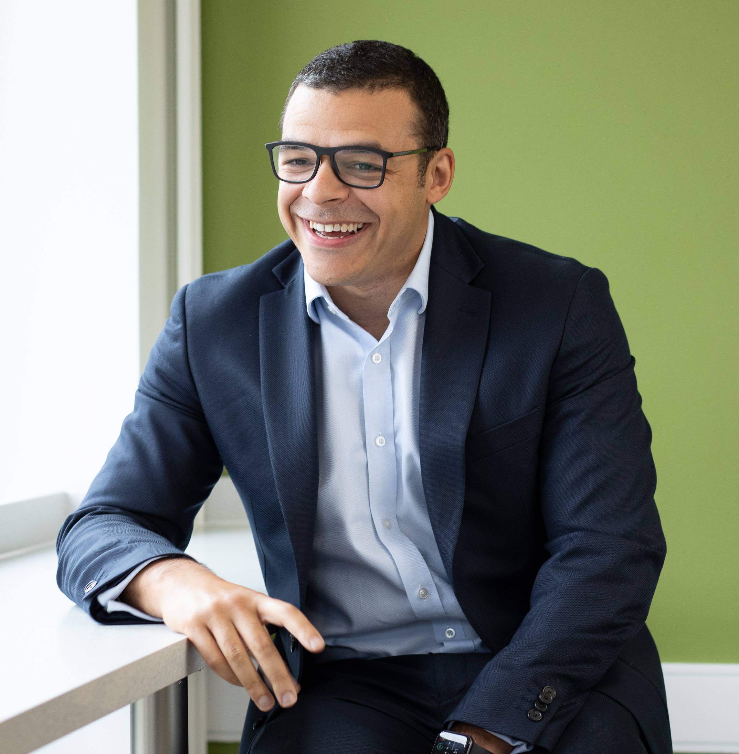
Nathan Talbott
Partner, Head of Commercial Litigation
T: 01926 880661
E: nathan.talbott@wrighthassall.co.uk

Slide 20
THANK YOU

Slide 21
LUNCH

